Slide 1
North Carolina’s
Changing Age Demographics and Challenges for the Future

Slide 2
1
Overview
The goal of this presentation is to examine the changing age demographics from 2000 to 2050 at the national, state and county level, to discuss the implications of this change, and to promote action within the community. The first part of this presentation will be concerned with data. The second part will outline the implications of the changing age demographic, and the third and final part will present a call to action. We hope to answer three questions related to the changes in the aging population: (1) What is going to happen? (2) What does this mean? And (3) What can we do?
So let’s get started
Goal: to examine the changing age demographics from 2000 to 2050 at the national, state and county level, discuss the implications of change, and promote action within the community.
Data –
U.S. Census Bureau
North Carolina Office of Budget and Management
Pew Research Center
2. Implications –
3. Call to Action –
What is going to happen?
What does this mean?
What can we do?
Notes:
The goal of this presentation is to examine the changing age demographics from 2000 to 2050 at the national, state and county level, to discuss the implications of this change, and to promote action within the community. The first part of this presentation will be concerned with data. The second part will outline the implications of the changing age demographic, and the third and final part will present a call to action. We hope to answer three questions related to the changes in the aging population: (1) What is going to happen? (2) What does this mean? And (3) What do we do?
So let’s get started

Slide 3
January 27, 2015
2
Notes:
Today is July 22, 2014. This presentation will cover a time period of 50 years: 2000 to 2050. So let’s go back in time.

Slide 4
January 1, 2011
3
On January 1, 2011, the Baby Boomers started turning 65. That was more than three years ago.
Flash forward 19 years, and on December 31, 2030, all living Boomers will be at least 65 years old, and the oldest boomers will start turning 85.
By December 31, 2050, all living Boomers will be at least 85 years old.
December 31, 2030
December 31, 2050
Notes:
On January 1, 2011, the Baby Boomers started turning 65. That was more than three years ago. Flash forward 19 years, and on December 31, 2030, all of the Boomers will be at least 65 years old. Jump ahead 20 more years, and the tail end of the Boomers will be at least 85 years old.

Slide 5
79.6 million
4
It’s called the Baby Boom for a reason. It was an unprecedented amount of births. Today we recognized the total population impact of the boomers as almost 80 million individuals, and that’s a number that has been adjusted for immigration.
So, 80 million boomers, divided by 19 years (the length of the entire Boomer generation), divided by 365 days—adjust for the number of people who don’t make it to 65, and you’re left with about 10,000 people turning 65 every day until 2030.
19 years
365 days
=
10,000
people turning 65 each day
Pew Research Center, 2008
Notes:
It’s called the Baby Boom for a reason. It was an unprecedented amount of births. Today we recognized the total population impact of the boomers as 79.6 million individuals, and that’s a number that has been adjusted for immigration. So, 79.6 million boomers, 19 years (2011-2030): let’s do some math. So, 79.6 million boomers, divided by 19 years, divided by 365 days—adjust for the number of people who don’t make it to 65, and you’re left with about 10,000 people turning 65 every day from 2011 to 2030.

Slide 6
5
Three years have passed since the Boomers started turning 65.
That’s about 12.6 million people who have already turned 65.
We are 16 years out from a two-fold increase in our elderly population.
January 27, 2015
Notes:
Today’s date has started to look a little different, right? Three years have passed since the Boomers started turning 65. That’s about 12.6 million people who have turned 65 in the past years. We are 16 years out from a two-fold increase in our elderly population.

Slide 7
An Aging Nation
6
What do all of these numbers mean? Our country is an aging nation. In the next thirty years, our country’s population demographic is going to change drastically. It’s 2014. 13 percent of the total U.S. population is over 65. By 2020, that number will increase to nearly 17 percent. By 2030, that number is projected to increase to 20 percent. That means that by 2030, one in five people are going to be over the age of 65. Census projections predict that by 2050, 21 percent of our nation’s population will be over 65.
Percent of U.S. Population over 65
2014: 13 percent
2020: 16.7 percent
2030: 20 percent
2050: 21 percent
Percent of US population over 65
Percent of US population age 0-64
Colby and Ortman, “The Baby Boom Cohort,” 2014
Notes:
What do all of these numbers mean? In the next thirty years, our country’s population demographic is going to change drastically. By 2030, the total aging population is expected to increase by nearly two-fold. Today, the elderly make up 13 percent of our total population. By 2020, 16 percent will be over 65. By 2030, that number is projected to increase to 20 percent. That means that by 2030, one in five people are going to be over the age of 65. Census projections predict that by 2050, 21 percent of our nation’s population will be over 65.

Slide 8
7
An Aging State
Aging Demographic changes are happening on a national scale. They’re also happening in North Carolina. We live in a very popular state, and seniors love to retire in North Carolina. North Carolina’s aging demographic changes are expected to exceed the national numbers
It’s 2014: 13.8 percent of the NC population is over 65. By 2030, 20 percent of the NC population is projected to be over 65. By 2050, we could see as many as 25 percent of the NC population over the age of 65.
Percent of North Carolina Population over 65
2014: 13.8 percent
2020: 16.8 percent
2030: 20 percent
2050: 25 percent
North Carolina Office of Budget and Management

Slide 9
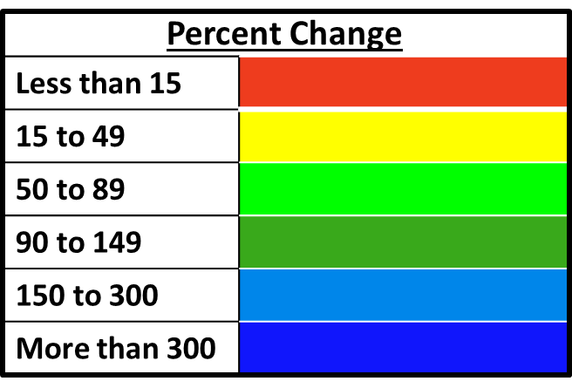
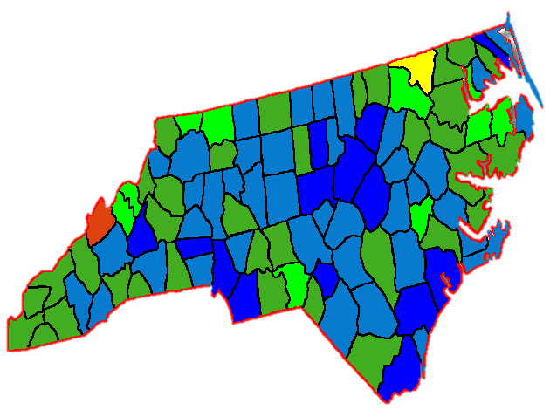
8
This map shows the total percent increase in the North Carolina population over 65 from 2000 to 2050 in each individual county. Dark blue indicates the most growth from 2000 to 2050, which red indicates the least growth. Red and yellow coloring indicates a percent increase of less than 50 percent. Light green indicates a 50 to 89 percent increase. Dark green indicates a 90 to 149 percent increase. Light blue indicates a 150 to 300 percent increase. And the dark blue indicates an increase of more than 300 percent.
From 2000 to 2050, the total NC population over 65 is expected to experience a percent increase of 247 percent.
An Aging State
North Carolina Populations over 65
2000 to 2050
Stokes
Rockingham
Surry
Wilkes
Yadkin
Forsyth
Guilford
Davie
Iredell
Davidson
Rowan
Cabarrus
Stanly
Mecklenburg

Slide 10
If we look specifically at HPCC’s service area, this graph shows total percent increase from 2000 to 2050 in the aging population of each of our 13 counties, ranging from the least growth on the left marked in light green, to the most growth on the right, marked in light blue.
Even our slowest growing county, Surry, nearly reaches a two-fold increase in its aging population by 2050.
The greatest growth of 284 percent will occur in Cabarrus county.
The red line indicates the NC total percent increase of 247 percent.
The stars mark counties that will more than triple (+200 percent increase) by 2050.
Our Service Area
NC Total Increase: 247%

Slide 11
We can zoom in on the top eight counties in our service area, all of which exceed a 150 percent increase in their aging populations by 2050
These counties are as follows from least growth to most growth:
Wilkes
Davidson
Forsyth
Stokes
Guilford
Davie
Iredell
Cabarrus
Again, the North Carolina total percent increase in the population over 65 is marked in red
Our Service Area
8 of our 13 counties are expected to experience at least a 150 percent increase in their populations over 65
NC Total Increase: 247%

Slide 12
Finally, we can look specifically at our top 4 counties
These four counties’ population over 65 will more than triple (+200 percent increase) by 2050
They are as follows from least growth to most growth
Guilford
Davie
Iredell
Cabarrus
Both Iredell and Cabarrus counties with exceed the North Carolina total percent increase value in the population over 65
Our Service Area
In 4 of our 13 counties, the population over 65 is expected to more than triple by 2050 (+200 percent increase), and Iredell and Cabarrus counties will exceed the state projection for percent increase in the population over 65
NC Total Increase: 247%

Slide 13
Forsyth – Total Population over 65
You’ve just seen an overview of percent increase from 2000 to 2050 for our 13-county service area, but depending upon where we take this data to present, we can cater our slides to the specific county. For example, if one of our Provider Coordinators was presenting at a Winston Salem Chamber event, or at a private physician practice in Forsyth County, they could use this slide to look specifically at Forsyth County. In Forsyth County, the population over 65 is expected to increase by 174.67 percent by 2050. Forsyth is one of 9 counties in our region that will exceed a 150 percent increase in its population over 65 by 2050. Although Forsyth County falls below the total NC percent increase in the population over 65, Forsyth’s percent increase is still substantial; the population over 65 more than doubles by 2050.
Percent Change from 2000 to 2050 in the Piedmont
2000-2010
2000-2020
2000-2030
2000-2050
Highlights
2000 to 2050: North Carolina is expected to experience a 247 percent increase in the population over 65
2000 to 2050: Forsyth County is expected to experience a 174.67 percent increase in the population over 65
Forsyth is one of 9 counties in our region that will exceed a 150 percent increase in its population over 65 by 2050

Slide 14
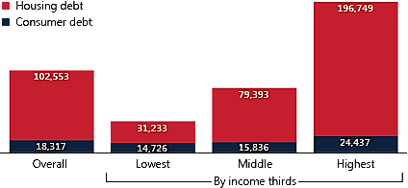
The aging population isn’t just going to age, they are going to retire, and probably at a greater rate than the past two decades since there will be more people reaching retirement age more quickly, right? Edward Siedle of Forbes would say no. He says we’re on the “precipice of the greatest retire crisis in the history of the world.” And before you cry “hyperbole,” take a look at these numbers.
The New School for Social Research estimates that 75 percent of Americans nearing retirement in 2010 had less than $30,000 in their retirement accounts.
Forbes 2013 article would agree, with independent experts estimating that the average 65 year old has $25,000 in their 401(k) account. Forbes says that the retirement planning industry estimates the average 65 year old has $100,000 in retirement assets.
$25,000 and $100,000 demonstrate a pretty big gap, but neither amount is enough to live on post-retirement:
$100,000 distributed evenly over a period of 25 years – age 65 to 90 – would allow roughly $330 per month;
$25,000 would allow $35 per month.
Data from the National Institute on Retirement may account for this discrepancy. The Institute measured the median near-retirement household (households with heads age 55-64) retirement assets at $12,000 in 2010, but near-retirement households (55-64) who owned retirement accounts had an estimated median retirement balance of $100,000. Those with higher incomes were more likely to own retirement accounts. 45 percent of the U.S. population did not own retirement accounts as of 2010.
So, the retirement industry’s $100,000 estimate may only reflect households who have retirement accounts, those who have tapped into the retirement industry, which is only 45 percent of the U.S. population, while not accounting for the remaining U.S. population that does not, which is what Forbes and The New School’s $25,000 estimate reflects.
13
Now that I have addressed the projected increase in the aging population, let’s take a look at what it means for the average American approaching the age of 65.
We might think that the growing aging population means greater retirement rates, but that may not be true.
Edward Siedle of Forbes says that the United States is “on the precipice of the greatest retirement crisis in the history of the world.”
The New School for Social Research estimates that 75 percent of Americans nearing retirement in 2010 had less than $30,000 in their retirement accounts.
Forbes independent experts would agree, estimating that the average 65 year old has $25,000 in retirement savings.
The retirement planning industry estimates that the average 65 year old has $100,000 in retirement savings.
Either way, neither amount is enough to live on. $100,000 spread evenly over a 25-year retirement period would yield about $330 dollars a month. $25,000 in retirement assets would yield $38 dollars per month.
Americans approaching retirement also have substantial debt. In 2010, 80.2 percent of near-retirees held some amount of household debt. Household debt is combined housing and consumer debt. Of those with debt, the average amount of household debt for near-retirees was about $120,000.
Financial Implications
Retirement Assets
Near-Retiree Debt
The New School for Social Research estimates that 75% of Americans nearing retirement in 2010 had less than $30,000 in their retirement accounts
Forbes, 2013
Independent experts estimate
the average 65 year old has $25,000 in retirement savings
That’s about $83 a month for 25 years of retirement
The retirement planning industry estimates
the average 65 year old has $100,000 in retirement savings
Even still, that’s only $330 a month for 25 years of retirement
Social Security Bulletin
In 2010 80.2 percent of “near-retirees” held household debt
The average household debt among all near-retiree households in 2010 was $120,871
“We are on the precipice of the greatest retirement crisis in the history of the world.”
- Edward Siedle, Forbes
$221,186
$120,871
$95,229
$45,959
Notes:
The aging population isn’t just going to age, they are going to retire, and probably at a greater rate than the past two decades since there will be more people reaching retirement age more quickly, right? Maybe not.
Edward Siedle of Forbes would say no. He says we’re on the “precipice of the greatest retire crisis in the history of the world.” And before you cry “hyperbole,” take a look at these numbers.
Independent experts estimate that the average 65 year old has $25,000 in their 401(k) account; the retirement planning industry estimates $100,000
$25,000 and $100,000 demonstrate a pretty big gap, but neither amount is enough to live on post-retirement ($100,000 distributed evenly over a period of 30 years – age 65 to 95 – would allow roughly $140 per month; $25,000 would allow $35 per month). Data from the National Institute on Retirement may account for this discrepancy. The Institute measured the median near-retirement household (households with heads age 55-64) retirement assets at $12,000 in 2010, but near-retirement households (55-64) who owned retirement accounts had an estimated median retirement balance of $100,000. Those with higher incomes were more likely to own retirement accounts. 45 percent of the U.S. population did not own retirement accounts as of 2010.

Slide 15
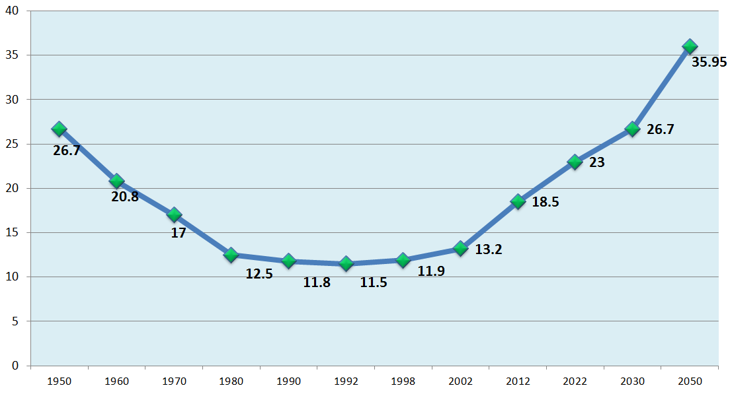
15
What does this mean?
Aging American are going to delay retirement.
Today, we see about 19 percent of Americans over 65 staying in the workforce beyond their 65th birthday.
By 2050, it is projected that nearly 36 percent of Americans over 65 will stay in the workforce beyond their 65th birthday.
This number mirrors a value we saw in the 1940s and 50s, when America was recovering from WWII and the Great-Depression and before the retirement age of 65 was introduced.
This graph shows projections for the percent of the U.S. population that will remain in the workforce beyond the age of 65.
Delaying retirement will certainly benefit aging Americans who have little to no retirement assets, but it may also alter our workforce.
As younger individuals enter the workforce and more than more older employees choose to stay, our workforces is going to become multigenerational. A multigenerational workforce with intergenerational outcomes means a change in workplace dynamics. Company leaders must prepare to meet these changes so that age diversity may benefit the workplace.
Implications in the work-place
Delayed retirement - the aging population will stay in the workforce longer
Projected Percent Population over 65 still in workforce
Highlights
2014: About 19 percent of the population over 65 is still in the workforce
2030: projected 26.7 percent of the population over 65 will stay in the workforce
2050: projected 35.95 percent of the population over 65 will stay in the workforce
Highlights:
In 1934, the retirement age of 65 was introduced, generating a marked decline in numbers of individuals over 65 in the workforce
The graph shows a turn from 1990 to 2000 and a steady climb from 2000 to 2050
2050: 35.95 percent of the population over 65 will remain in the workforce
Projections for 2030 and 2050 are based on the percent increase from 1990 to 2012 and a projected value for 2022
1950
2000
1990
2010
2030
2050
%
What does this mean?
Multigenerational workforce
Intergenerational outcomes
+
=
Change in workplace dynamics
Younger individuals entering workforce
Older employees staying in workforce
Notes:
In 1934, the “retirement age” of 65 was introduced. Before its introduction, a great deal of individuals over 65 remained in the workforce. Before the turn of the 20th century, 78 percent of men stayed at work well beyond their 65th birthday, and that was when life-expectancy was much lower. After 1934, the number of people who remained in the workforce beyond their 65 birthday decreased, dipping lowest in 1992 with only 11.5 percent of individuals over 65 staying in the workforce. But that number has begun to rise. Today we see about 18.5 percent of individuals over 65 stay in the workforce. By 2030, that number will be nearly 27 percent, and will reach nearly 36 percent by 2050, exceeding the percent value of the post-depression and post-WWII America in the 1950s.

Slide 16
Changing age demographics will also affect disease demography.
Chronic conditions—such as diabetes, Alzheimer’s, cardiovascular disease, and cancer—all take their greatest toll on the aging population, with the majority of cases occurring in individuals over 65. The top six leading causes of death in the population over 65 are all chronic conditions.
I want to zoom in on these four chronic conditions: Diabetes, Alzheimer’s, cardiovascular disease, and cancer.
Today, 9.3 percent of Americans have diabetes. By 2050, that number is expected to increase, to 21 to 33 percent of Americans with diabetes.
Today, 37 percent of Americans have at least one type of CVD. By 2030, between 40.5 and 44 percent of Americans will have CVD
Today, 11 percent of the population over 65 has Alzheimer’s. By 2050, 16.5 percent of Americans over 65 will have Alzheimer’s.
And, today, 60 percent of cancer patients are over 65. By 2050, it is expected that 73 percent of cancer patients will be over 65, that’s nearly three-quarters of all cancer patients.
Medical Implications
Changing age demographics = changing disease demographics
2014
2030
2050
Diabetes | 9.3 percent of the U.S. population has diabetes |  |  |  | Between 21 and 33 percent of the U.S. population will have diabetes
Cardiovascular Disease (CVD) | 37 percent of Americans have at least one type of CVD |  | Between 40.5 and 44 percent of Americans will have CVD*
Alzheimer’s | 11 percent of Americans over 65 have Alzheimer’s |  |  |  | 16.5 percent of Americans over 65 will have Alzheimer’s
Cancer | 60 percent of cancer patients are over 65 |  |  |  | 73 percent of cancer patients will be over 65
*The American Heart Association’s prevalence projections extend only until 2030. No data sets for 2050 projections.
Data from CDC National Diabetes Statistics Report, 2014; Boyle et al. Population Health Metrics, 2010; Alzheimer’s Association, 2014 Alzheimer’s Disease Facts and Figures; Go, Mozaffarian, Roger et al. “Heart Disease and Stroke Statistics – Update 2014: A Report From the American Heart Association”; Heidenreich et al. The American Heart Association, 2011; Smith et al. (2009) Journal of Clinical Oncology.

Slide 17
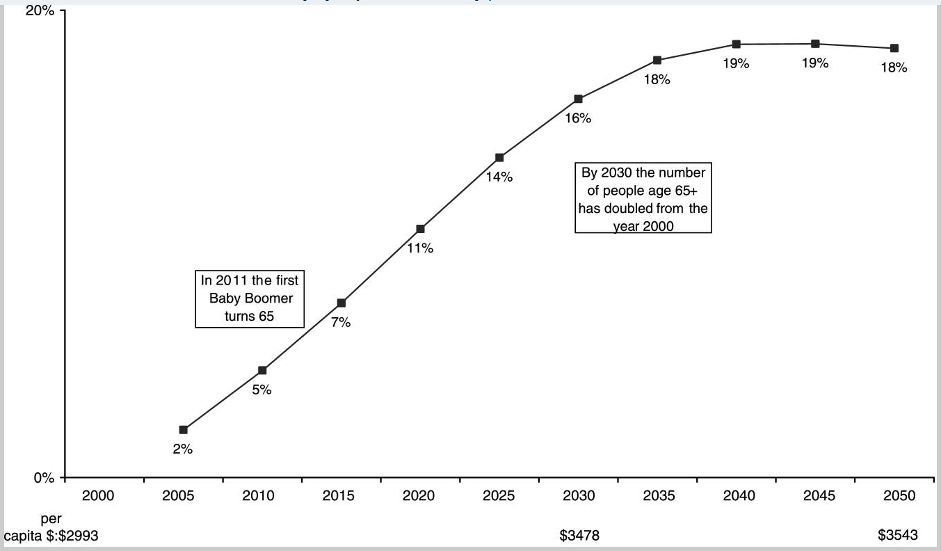
19
With an increase in chronic disease prevalence comes an increase in health care costs. Chronic conditions are especially expensive, because they affect the body for long periods of time.
This graph demonstrates the impact of aging on health care costs from 2000 until 2050. It shows the cumulative percent change in health care per capita costs due to national aging. So this is the effect that aging will have on health care costs – the percent increase in health care costs due to aging.
Today we recognized about a 7 percent increase in per capita costs since 2000.
That increase will peak in 2040 with a 19 percent increase from 2000 in per capita health care costs due to aging.
In plain numbers, it’s an increase from $2,993 per capita health care costs in 2000 to $3,543 per capita health care costs in 2050.
Health Care Costs
Cumulative Percent Change in Health Care per Capita Costs Due to Aging, United States 2000-2050
Highlights
2000-2014: less than a 7 percent increase in the cumulative health care per capita costs due to aging in the United States
2000-2040: percent change will peak at a 19 percent increase in health care per capita costs due to aging
2000-2050: Per capita health care costs will increase from $2,993 to $3,543
Martini, Garrett, Lindquist and Isham.. “The Boomers Are Coming: A Total Cost of Care Model of the Impact of Population Aging on Health Care Costs in the United States by Major Practice Category.” Health Services Research. Feb 2007

Slide 18
So…now what?
It starts with you
Thinking about yourself and planning for what you want.
End of life planning:
Advanced care planning for you and your loved ones
Retirement
Financial
20
So now what? I’ve just supplied a lot of information, and it may seem a little scary.
Now what can we do? How do we prepare for this change?
Plan for yourself.
As a nation, state, region and county, we will change, but as individuals we will also change. Therefore, as individuals we need to prepare ourselves. We need plan for ourselves.
Advance care planning is one way to prepare for aging, death and dying. Accidents, diseases and healthcare emergencies happen, and it’s important to be prepared for these situations by deciding, discussing, and documenting your healthcare wishes. Have conversations with your loved ones about what you would want if you were unable to speak for yourself, and encourage your loved ones to share their wishes with you.
2. Plan for your workplace
You are employers, company leader, you are in a position of leadership and now you have the power of knowledge. Plan and prepare for the changes that are going to happen. Understand the resources you have available to your employees and address the areas that are lacking. Analyze your own employee demographic. Understand the strength of the need and impending need within your business. Host an Advance Care Planning workshop, encourage Advance Care Planning and End-of-Life Planning in your company wellness programs.
3. Coordinate within your community.
You are chamber leaders, you’re all here because you believe in intercommunity interaction. You believe in sharing ideas and working together to promote action. Understand what resources you as a collective community have to offer your aging population, and brainstorm new ways you can help. Get together, network. You capabilities can only increase with collaboration.
1
Ensure you have the resources to support the changing landscape.
Assess wellness programs, analyze your employee demographic – who has made plans, who still needs to
Promote learning opportunities
Medical workplaces: get prepared for intake
Plan for yourself
2
Plan for your workplace
As a leader, promote action within your community as well.
Coordination and collaboration
3
Promote action within your community

Slide 19
21
Advance Care Planning
What is advance care planning?
Advance care planning is a process where you reflect upon and plan for the healthcare you would want if you were unable to make decisions or speak for yourself.
What is an advance directive?
An advance directive is a legal document that records your wishes in writing and helps ensure your wishes are known and honored.
“Living Will”: a document that describes your preferences for medical treatment and life support
“Health Care Power of Attorney”: a document that allows you to name your “Health Care Agent”: the individual(s) you would like to speak for you if you are unable to speak for yourself
It’s as simple as 1, 2, 3…
1
Decide what kind of health care you would want and who you would want to speak for you if you could not speak for yourself
We plan for
college, marriage,
a baby, & retirement…
but we don’t prepare
for the end of life.
Let’s change that!
2
Discuss your wishes with your loved ones and healthcare providers
3
Document your wishes in the form of an advance directive
www.GotPlans123.org

Slide 20
My wish for you in this region
52 percent of our patients are with us for 14 days or less.
Of that 52 percent, 33 percent of people are with us for less than 7 days. Yet, people spend 9 months preparing for the birth of a child. I’ve shared the data, I’ve shared the implications.
We can either shape this region, or the region will be shaped for us.
This is personal. It’s what I see every day. I firmly believe that people can pull together and plan for the future, or it will be planned for them.
What I’ve learned from patients that I’ve served is that every day you can make a big contribution, we have to make every day count.
I hope that what you’ve heard today will not just alarm you, but inspire you to lead and take action.

Slide 21
Sources
Census, Population Estimates and Projections:
North Carolina Office of Budget and Management – Population Estimates and Projections http://www.osbm.state.nc.us/index.shtm
American FactFinder - 2000 and 2010 Census Data. http://factfinder2.census.gov/faces/nav/jsf/pages/index.xhtml
“The Baby Boom Cohort in the United States: 2012 to 2060.” Sandra L. Colby and Jennifer M. Ortman, May 2014, Current Population Reports, Population Estimates and Projections, United States Census. http://www.census.gov/prod/2014pubs/p25-1141.pdf
“U.S. Population Projections: 2005-2050,” Jeffrey S. Passel and D’Vera Cohn, Pew Research Center, February 2008. www.pewresearch.org
Centers for Disease Control and Prevention. The State of Aging and Health in America 2013. Atlanta, GA: Centers for Disease Control and Prevention, US Department of Health and Human Services, 2013.
Retiree Assets and Debt:
Anguelov and Tamborini. United States Social Security Website – Office of Retirement Policy – “Near-Retirees are Holding Substantial Debt.” Social Security Bulletin, 2010. http://www.ssa.gov/retirementpolicy/research/debt-trend.html
David Bernard, “The Baby Boomer Number Game,” US News and World Report, 23 March 2012, Web. http://money.usnews.com/money/blogs/on-retirement/2012/03/23/the-baby-boomer-number-game

Slide 22
Sources
Siedle, Edward. “The Greatest Retirement Crisis in American History.” Forbes Online. 20 March 2013. Accessed July 2014. http://www.forbes.com/sites/edwardsiedle/2013/03/20/the-greatest-retirement-crisis-in-american-history/
Braedyn Kromer and David Howard, “Labor Force Participation and Work Status of People 65 Years and Older,” American Community Survey Briefs, U.S. Census, 2013. http://www.census.gov/prod/2013pubs/acsbr11-09.pdf
Kelly A. Holder and Sandra L. Clark, “Working Beyond Retirement-Age,” U.S. Census Bureau Housing and Household Economics Division Labor Force Statistics Branch, Presented 2008
https://www.census.gov/hhes/www/laborfor/Working-Beyond-Retirement-Age.pdf
Disease Prevalence and Projections:
Boyle, Honeyvutt, Narayan, Hoerger, Geiss, Chen and Thompson. “Projection of Diabetes Burden Through 2050: Impact of changing demography and disease prevalence in the U.S.” American Diabetes Association
http://care.diabetesjournals.org/content/24/11/1936.long
Alzheimer’s Association, 2014 Alzheimer’s Disease Facts and Figures, Alzheimer’s & Dementia, Volume 10, Issue 2. Web. http://www.alz.org/downloads/Facts_Figures_2014.pdf

Slide 23
Sources
Heart Disease and Stoke Statistics—2014 Update: A Report from the American Heart Association. American Heart Association. Circulation, 2014. http://circ.ahajournals.org/content/129/3/e28.full.pdf+html
“Forecasting the Future of Cardiovascular Disease in the United States: A Policy Statement from the American Heart Association, Heidenreich et al. The American Heart Association, 2011. http://circ.ahajournals.org/content/123/8/933.long#T6
Martini, Garrett, Lindquist and Isham.. “The Boomers Are Coming: A Total Cost of Care Model of the Impact of Population Aging on Health Care Costs in the United States by Major Practice Category.” Health Services Research. Feb 2007. http://www.ncbi.nlm.nih.gov/pmc/articles/PMC1955745/
“National Diabetes Statistics Report, 2014. National Center for Chronic Disease Prevention and Health Promotion. Division of Diabetes Translation. CDC. http://www.cdc.gov/diabetes/pubs/statsreport14/national-diabetes-report-web.pdf
Boyle et al. “Projection of the year 2050 burden of diabetes in the U.S. adult population: dynamic modeling of incidence, mortality, and prediabetes prevalence.” Population Health Metrics 8.29, 2010. http://www.pophealthmetrics.com/content/8/1/29

Slide 24
Sources
Go, Mozaffarian, Roger et al. “Heart Disease and Stroke Statistics – Update 2014: A Report From the American Heart Association.” Circulation. American Heart Association and American Stoke Association. 2013. http://www.heart.org/idc/groups/ahamahpublic/@wcm/@sop/@smd/documents/downloadable/ucm_459072.pdf
Smith et al. “Future of Cancer Incidence in the United States: Burdens Upon an Aging, Changing Nation. Journal of Clinical Oncology 27. American Society of Clinical Oncology, 2009. file:///C:/Users/Mary%20Taylor/Downloads/future-of-cancer-incidence-in-the-united-states-journal-of-clinical-oncology%20(1).pdf
Murphy, Sherry L., Jiaquan Xu, and Kenneth D. Kochanek. “Deaths: Preliminary Data for 2010.” National Vital Statistics Reports 60.4. U.S. Department of Health and Human Services. Centers for Disease Control and Prevention. National Center for Health Statistics. 2012.
Newport, Frank. “Twelve Ways Baby Boomers Will Shape the Nation in the Coming Decades.” Polling Matters. Gallup. 24 January 2014. http://pollingmatters.gallup.com/2014/01/twelve-ways-baby-boomers-will-shape.html

Slide 25
Acknowledgments
We would like to thank Jennifer Song, the state demographer for the North Carolina Office of Budget and Management, for her assistance with questions regarding population projection data.
We would like to thank Angela Mariotto of the National Cancer Institute for her assistance with questions regarding cancer prevalence projections.
We would like to thank Dr. James Johnson of the University of North Carolina at Chapel Hill for his inspiration and motivation.
Thank you!
Notes:
Jennifer Song, Dr. James Johnson, any others? Iredell Chamber?

Slide 26
Index
County | 2000 Population | 2010 Population | % Change 2000-2010 | 2020 Population | % Change 2010-2020 | % Change 2000-2020 | 2030 Population | % Change 2020-2030 | % Change 2000-2030 | 2050 Population | % Change 2030-2050 | % Change 2000-2050
Cabarrus | 8,102 | 11,474 | 41.62% | 17,579 | 53.21% | 116.97% | 23,738 | 35.04% | 192.99% | 34,162 | 43.91% | 321.65%
Davidson | 10,498 | 13,644 | 29.97% | 18,321 | 34.28% | 74.52% | 21,173 | 15.57% | 101.69% | 28,290 | 33.61% | 169.48%
Davie | 2,588 | 3,846 | 48.61% | 5,173 | 34.50% | 99.88% | 5,726 | 10.69% | 121.25% | 7,818 | 36.54% | 202.09%
Forsyth | 21,000 | 24,420 | 16.29% | 37,085 | 51.86% | 76.60% | 43,078 | 16.16% | 105.13% | 57,797 | 34.17% | 175.22%
Guilford | 26,643 | 32,505 | 22.00% | 51,317 | 57.87% | 92.61% | 61,411 | 19.67% | 130.50% | 84,590 | 37.74% | 217.49%
Iredell | 8,393 | 11,944 | 42.31% | 17,755 | 48.65% | 111.55% | 23,595 | 32.89% | 181.13% | 33,730 | 42.95% | 301.88%
Mecklenburg | 32,357 | 46,106 | 42.49% | 84,770 | 83.86% | 161.98% | 117,497 | 38.61% | 263.13% | 174,257 | 48.31% | 438.54%
Rockingham | 7,297 | 8,480 | 16.21% | 11,050 | 30.31% | 51.43% | 11,835 | 7.10% | 62.19% | 14,860 | 25.56% | 103.65%
Rowan | 9,360 | 10,389 | 10.99% | 15,379 | 48.03% | 64.31% | 17,752 | 15.43% | 89.66% | 23,347 | 31.52% | 149.43%
Stanly | 4,433 | 5,311 | 19.81% | 7,175 | 35.10% | 61.85% | 8,261 | 15.14% | 86.35% | 10,813 | 30.89% | 143.92%
Stokes | 2,898 | 4,440 | 53.21% | 5,453 | 22.82% | 88.16% | 6,026 | 10.51% | 107.94% | 8,111 | 34.61% | 179.89%
Surry | 5,773 | 6,755 | 17.01% | 8,499 | 25.82% | 47.22% | 8,944 | 5.24% | 54.93% | 11,058 | 23.64% | 91.55%
Wilkes | 5,157 | 6,820 | 32.25% | 8,712 | 27.74% | 68.94% | 9,452 | 8.49% | 83.28% | 12,315 | 30.29% | 138.81%
Yadkin | 2,858 | 3,570 | 24.91% | 4,205 | 17.79% | 47.13% | 4,630 | 10.11% | 62.00% | 5,811 | 25.51% | 103.34%
NC Total | 533,777 | 703,964 | 31.88% | 1,056,157 | 50.03% | 97.86% | 1,251,320 | 18.48% | 134.43% | 1,641,646 | 31.19% | 207.55%
Percent Change – Population Projections until 2050 – ages 65 to 74 by County

Slide 27
Index
County | 2000 Population | 2010 Population | % Change 2000-2010 | 2020 Population | % Change 2010-2020 | % Change 2000-2020 | 2030 Population | % Change 2020-2030 | % Change 2000-2030 | 2050 Population | % Change 2030-2050 | % Change 2000-2050
Cabarrus | 5,366 | 6,212 | 15.77% | 8,709 | 40.20% | 62.30% | 13,125 | 50.71% | 144.60% | 18,298 | 39.41% | 240.99%
Davidson | 6,330 | 7,390 | 16.75% | 9,583 | 29.68% | 51.39% | 12,897 | 34.58% | 103.74% | 17,275 | 33.95% | 172.91%
Davie | 1,664 | 2,161 | 29.87% | 2,885 | 33.50% | 73.38% | 3,945 | 36.74% | 137.08% | 5,466 | 38.55% | 228.47%
Forsyth | 13,012 | 15,330 | 17.81% | 17,958 | 17.14% | 38.01% | 27,023 | 50.48% | 107.68% | 36,364 | 34.57% | 179.46%
Guilford | 16,878 | 19,777 | 17.18% | 24,751 | 25.15% | 46.65% | 38,587 | 55.90% | 128.62% | 53,060 | 37.51% | 214.37%
Iredell | 5,137 | 6,487 | 26.28% | 8,972 | 38.31% | 74.65% | 13,120 | 46.23% | 155.40% | 18,442 | 40.56% | 259.00%
Mecklenburg | 20,507 | 25,076 | 22.28% | 37,083 | 47.88% | 80.83% | 66,030 | 78.06% | 221.99% | 96,379 | 45.96% | 369.98%
Rockingham | 4,681 | 4,876 | 4.17% | 5,808 | 19.11% | 24.08% | 7,693 | 32.46% | 64.35% | 9,701 | 26.10% | 107.24%
Rowan | 6,603 | 6,533 | -1.06% | 7,685 | 17.63% | 16.39% | 10,999 | 43.12% | 66.58% | 13,930 | 26.64% | 110.96%
Stanly | 2,952 | 3,115 | 5.52% | 3,824 | 22.76% | 29.54% | 5,252 | 37.34% | 77.91% | 6,785 | 29.20% | 129.86%
Stokes | 1,772 | 2,276 | 28.44% | 2,929 | 28.69% | 65.29% | 3,808 | 30.01% | 114.90% | 5,165 | 35.64% | 191.50%
Surry | 3,874 | 3,936 | 1.60% | 4,688 | 19.11% | 21.01% | 5,936 | 26.62% | 53.23% | 7,311 | 23.16% | 88.71%
Wilkes | 3,080 | 3,624 | 17.66% | 5,001 | 38.00% | 62.37% | 6,341 | 26.79% | 105.88% | 8,515 | 34.28% | 176.46%
Yadkin | 1,720 | 1,991 | 15.76% | 2,433 | 22.20% | 41.45% | 2,949 | 21.21% | 71.45% | 3,768 | 27.78% | 119.09%
NC Total | 329,810 | 391,108 | 18.59% | 529,216 | 35.31% | 60.46% | 789,364 | 49.16% | 139.34% | 1,309,660 | 65.91% | 297.10%
Percent Change – Population Projections until 2050 – ages 75 to 84 by County

Slide 28
Index
County | 2000 Population | 2010 Population | % Change 2000-2010 | 2020 Population | % Change 2010-2020 | % Change 2000-2020 | 2030 Population | % Change 2020-2030 | % Change 2000-2030 | 2050 Population | % Change 2030-2050 | %Change 2000-2050
Cabarrus | 1,696 | 2,524 | 48.82% | 2,916 | 15.53% | 71.93% | 4,178 | 43.28% | 146.34% | 5,833 | 39.60% | 243.91%
Davidson | 1,946 | 2,474 | 27.13% | 3,068 | 24.01% | 57.66% | 4,045 | 31.84% | 107.86% | 5,444 | 34.59% | 179.77%
Davie | 555 | 864 | 55.68% | 1,107 | 28.13% | 99.46% | 1,502 | 35.68% | 170.63% | 2,133 | 42.03% | 284.38%
Forsyth | 4,537 | 6,012 | 32.51% | 7,404 | 23.15% | 63.19% | 8,848 | 19.50% | 95.02% | 11,722 | 32.48% | 158.36%
Guilford | 5,955 | 8,271 | 38.89% | 10,320 | 24.77% | 73.30% | 13,355 | 29.41% | 124.27% | 18,288 | 36.94% | 207.11%
Iredell | 1,620 | 2,129 | 31.42% | 2,855 | 34.10% | 76.23% | 4,028 | 41.09% | 148.64% | 5,633 | 39.85% | 247.74%
Mecklenburg | 6,860 | 10,737 | 56.52% | 14,564 | 35.64% | 112.30% | 21,735 | 49.24% | 216.84% | 31,652 | 45.63% | 361.39%
Rockingham | 1,638 | 1,879 | 14.71% | 2,000 | 6.44% | 22.10% | 2,478 | 23.90% | 51.28% | 3,038 | 22.60% | 85.47%
Rowan | 2,242 | 2,626 | 17.13% | 2,709 | 3.16% | 20.83% | 3,302 | 21.89% | 47.28% | 4,009 | 21.40% | 78.80%
Stanly | 880 | 1,097 | 24.66% | 1,268 | 15.59% | 44.09% | 1,613 | 27.21% | 83.30% | 2,102 | 30.30% | 138.83%
Stokes | 608 | 869 | 42.93% | 912 | 4.95% | 50.00% | 1,238 | 35.75% | 103.62% | 1,658 | 33.93% | 172.70%
Surry | 1,326 | 1,581 | 19.23% | 1,638 | 3.61% | 23.53% | 1,982 | 21.00% | 49.47% | 2,419 | 22.07% | 82.45%
Wilkes | 1,009 | 1,361 | 34.89% | 1,669 | 22.63% | 65.41% | 2,284 | 36.85% | 126.36% | 3,134 | 37.22% | 210.60%
Yadkin | 566 | 701 | 23.85% | 856 | 22.11% | 51.24% | 1,037 | 21.14% | 83.22% | 1,351 | 30.28% | 138.69%
NC Total | 105,461 | 149,052 | 41.33% | 191,009 | 28.15% | 81.12% | 264,477 | 38.46% | 150.78% | 411,413 | 55.56% | 290.11%
Percent Change – Population Projections until 2050 – ages 85 and older by County

