Slide 1
The Community Partnership for Compassionate Care

Slide 2
Representatives
F Keith Stirewalt PA MBA MDiv – fstirewa@wakehealth.edu
Chaplain for Clinical Engagement & Living Donor Advocate
Wake Forest Baptist Medical Center
Winston-Salem NC
Christine Brown
Regional Vice President of Business Development
Hospice & Palliative CareCenter
Rowan Hospice & Palliative CareCenter
Christine.Brown@hospicecarecenter.org

Slide 3
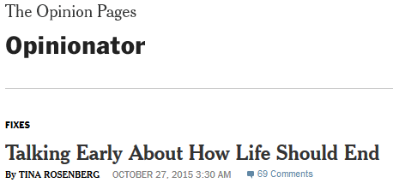
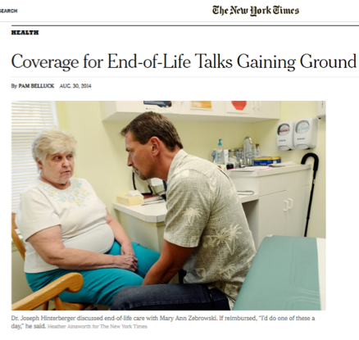
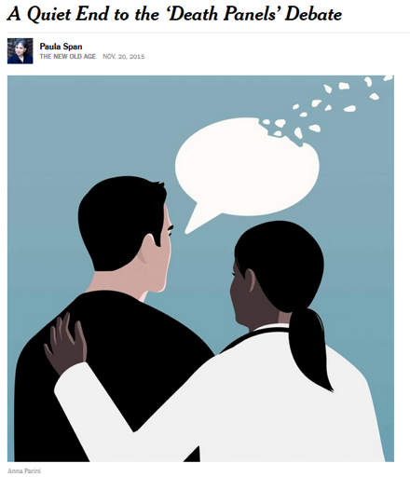
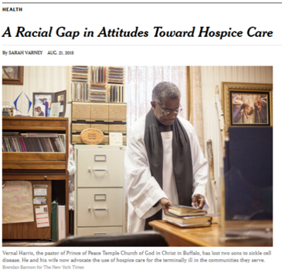
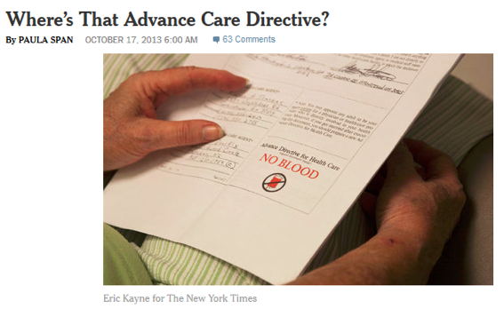
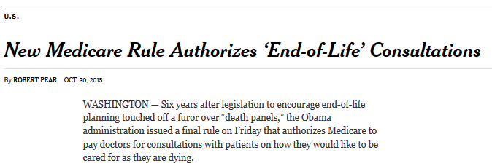
Advance Care Planning is becoming increasingly ‘sexy’

Slide 4
Yet…...
Stats on Advance Care Planning
Conversation Project Survey 2013
90% of people say talking to their loved ones about end-of-life is important
27% report having done so
California HealthCare Foundation 2012
82% of people say it’s important to put their wishes in writing
23% report actually having done so
California HealthCare Foundation 2012
80% say that they would want to talk to their physicians about end-of-life care if they become seriously ill
7% report that they have actually had a conversation with their health care provider

Slide 5
Studies
“Patient-Reported Barriers to High-Quality, End-of-Life Care: A Multiethnic, Multilingual, Mixed Methods Study” – Journal of Palliative Medicine. Vol. 18, Number X, 2015
387 patients of multiethnic backgrounds Caucasian/Asian American/African American/Hispanic Americans
Despite assumptions about ethnic minorities who want “everything done”, the study found that all groups desired “conversations with their physicians about quality end-of-life care”
Barriers Cited:
Finance/Health Insurance
Doctor behaviors
Communication chasm between doctors and patients
Family behaviors and beliefs
Health care system barriers
Cultural and religious barriers

Slide 6
Personal Experience…
During my presentations, about 50% of medical people report having ADs
It’s obvious that, no matter how sexy a topic it is to us, we have a long way to go…we are missing significant portions of the population

Slide 7
Contextualization
Observation: Despite increased media and medical attention to advance care planning, we are faltering in our attempt to normalize ACP conversations
Thesis: Effective normalization of ACP necessitates contextualization of education formats
Just as marketing methods are segmented to more effectively reach different segments of the population, ACP education should be customized for the needs of the audience
Take for instance…

Slide 8
Genesis Patient

Slide 9
A Contextual Approach to ACP Education for Spanish Speakers
Concept genesis, development, and project leaders: Keith and Gerardo Maradiaga MA, Bioethics Project Leader at Wake Forest Baptist Medical Center
‘Ecumenical team’ of WFBMC ethics, chaplaincy, and clinical personnel
Two generous grants received from:
Center for Bioethics, Health and Society – Wake Forest University
Maya Angelou Center for Health Equity – Wake Forest University School of Medicine
Desire to ‘share’ educational tools

Slide 10
A Contextual Approach to ACP Education for Spanish Speakers
Decision for a contextual education
Lack of educational resources in the Piedmont Triad Region for Spanish Speakers
Dispelling of myths, fears, and misconceptions (both legal and ethical)
Differences in delivery (and transition) of care between native countries and care offered in NC
Cultural differences that affect ACP in many Spanish Speakers
The role of the family
The perception of death
Paternalism

Slide 11
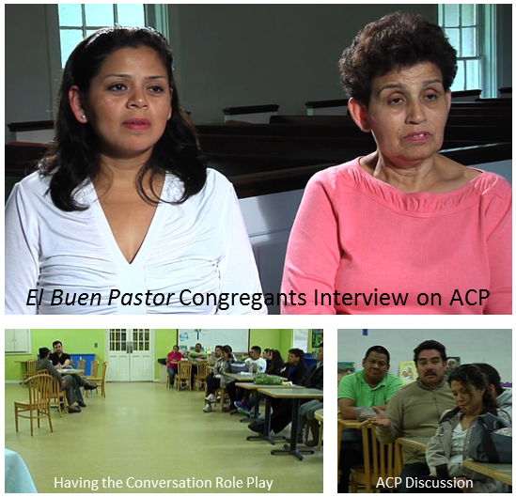
A Contextual Approach to ACP Education for Spanish Speakers
Focus Group
Make-up of Focus Group
Challenges
Educational Component
Completing Documents
Lessons Learned

Slide 12
A Contextual Approach to ACP Education for Spanish Speakers
Challenges / Lessons
Who is our audience?
Latino? Hispanic? “Spanish Speakers”?
Practical Vs. Comprehensive?
What do we prioritize?
What do we leave in / out?
Reading Level?
Language / Colloquialisms
Medium?
Funding
Scheduling
Scripts / Actors / Scheduling

Slide 13
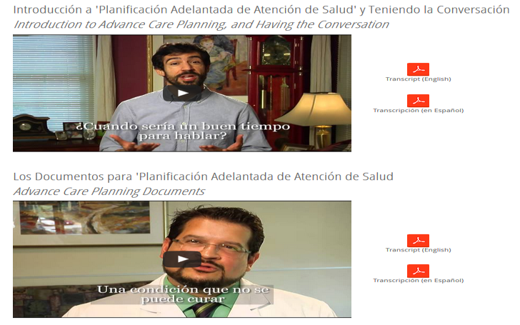
A Contextual Approach to ACP Education for Spanish Speakers
Finished Project – Videos and Web Presentation http://www.gotplans123.org/#!en-espanol/c24u5

Slide 14
Contextualization of Education: A multifaceted call to action
Language
Reading level - “An Advance Directive for North Carolina: A Practical Form for All Adults”
Spanish-language versions in series (Spanish-English)
Korean and Russian versions created by our friends at MAHEC
Other languages coming?
Age
“A sea of blue hair and bald spots”
How do we convince younger, healthier patients of the need for “the conversation”?
Financial counselor
Reaching into the work place – Leadership Winston-Salem
Technological ability and desire
www.gotplans123.org
Geared for public consumption
Spanish-language section
Developing video for forms completion – Jennifer Stuart and others from MAHEC

Slide 15
Contextualization of Education: A multifaceted call to action
Transportation logistics
Public presentations
When and where?
Theological influences
“A Whole ‘Nuther” presentation
“Failure to understand patient perception and reception of their health through their theological lens is a failure to understand the patient” - Keith
Must include the buy-in of faith leaders

