Slide 1
North Carolina Partnership for Compassionate Care

Slide 2
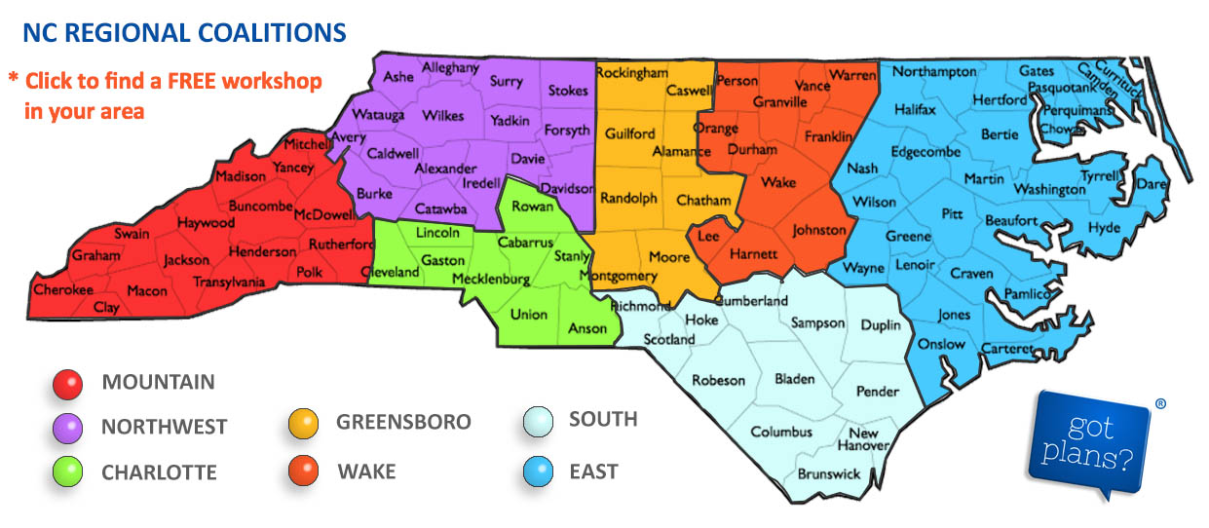

Slide 3
The North Carolina Medical Society Foundation (NCMSF),
the North Carolina Bar Association (NCBA), and the Community Partnership for Compassionate Care (CPCC) are pleased to announce a unification of our efforts to promote patients’ end-of-life care choices.
We are very excited about the unification of efforts and our new home. We are confident that by joining together, we will have a positive and discernable impact on advance care planning throughout North Carolina. Planning now is critical for our aging state.

Slide 4
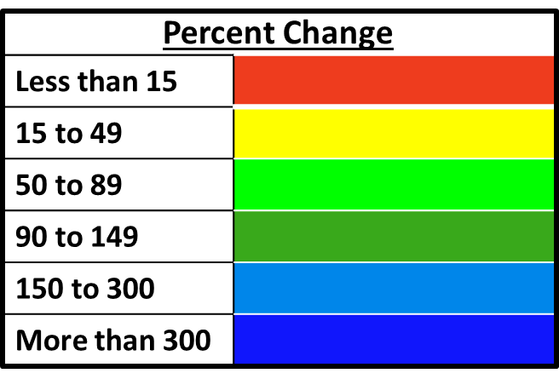
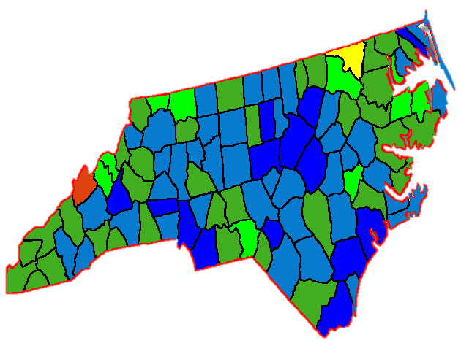
An Aging State
North Carolina Populations over 65
2000 to 2050
Stokes
Rockingham
Surry
Wilkes
Yadkin
Forsyth
Guilford
Davie
Iredell
Davidson
Rowan
Cabarrus
Stanly
Mecklenburg

Slide 5
79.6 million
19 years
365 days
=
10,000
people turning 65 each day

Slide 6
An Aging Nation
Percent of U.S. Population over 65
2014: 13 percent
2020: 16.7 percent
2030: 20 percent
2050: 21 percent
Percent of US population over 65
Percent of US population age 0-64

Slide 7
North Carolina State Demographic
Percent of North Carolina Population over 65
2014: 13.8 percent
2020: 16.8 percent
2030: 20 percent
2050: 25 percent

Slide 8
Medical Implications
Changing age demographics = changing disease demographics
2014
2030
2050
Diabetes | 9.3 percent of the U.S. population has diabetes |  |  |  | Between 21 and 33 percent of the U.S. population will have diabetes
Cardiovascular Disease (CVD) | 37 percent of Americans have at least one type of CVD |  | Between 40.5 and 44 percent of Americans will have CVD*
Alzheimer’s | 11 percent of Americans over 65 have Alzheimer’s |  |  |  | 16.5 percent of Americans over 65 will have Alzheimer’s
Cancer | 60 percent of cancer patients are over 65 |  |  |  | 73 percent of cancer patients will be over 65
*The American Heart Association’s prevalence projections extend only until 2030. No data sets for 2050 projections.
Data from CDC National Diabetes Statistics Report, 2014; Boyle et al. Population Health Metrics, 2010; Alzheimer’s Association, 2014 Alzheimer’s Disease Facts and Figures; Go, Mozaffarian, Roger et al. “Heart Disease and Stroke Statistics – Update 2014: A Report From the American Heart Association”; Heidenreich et al. The American Heart Association, 2011; Smith et al. (2009) Journal of Clinical Oncology.

Slide 9
So…now what?
1
Plan for yourself
2
Plan for your healthcare system
Promote action within your community
3

Slide 15
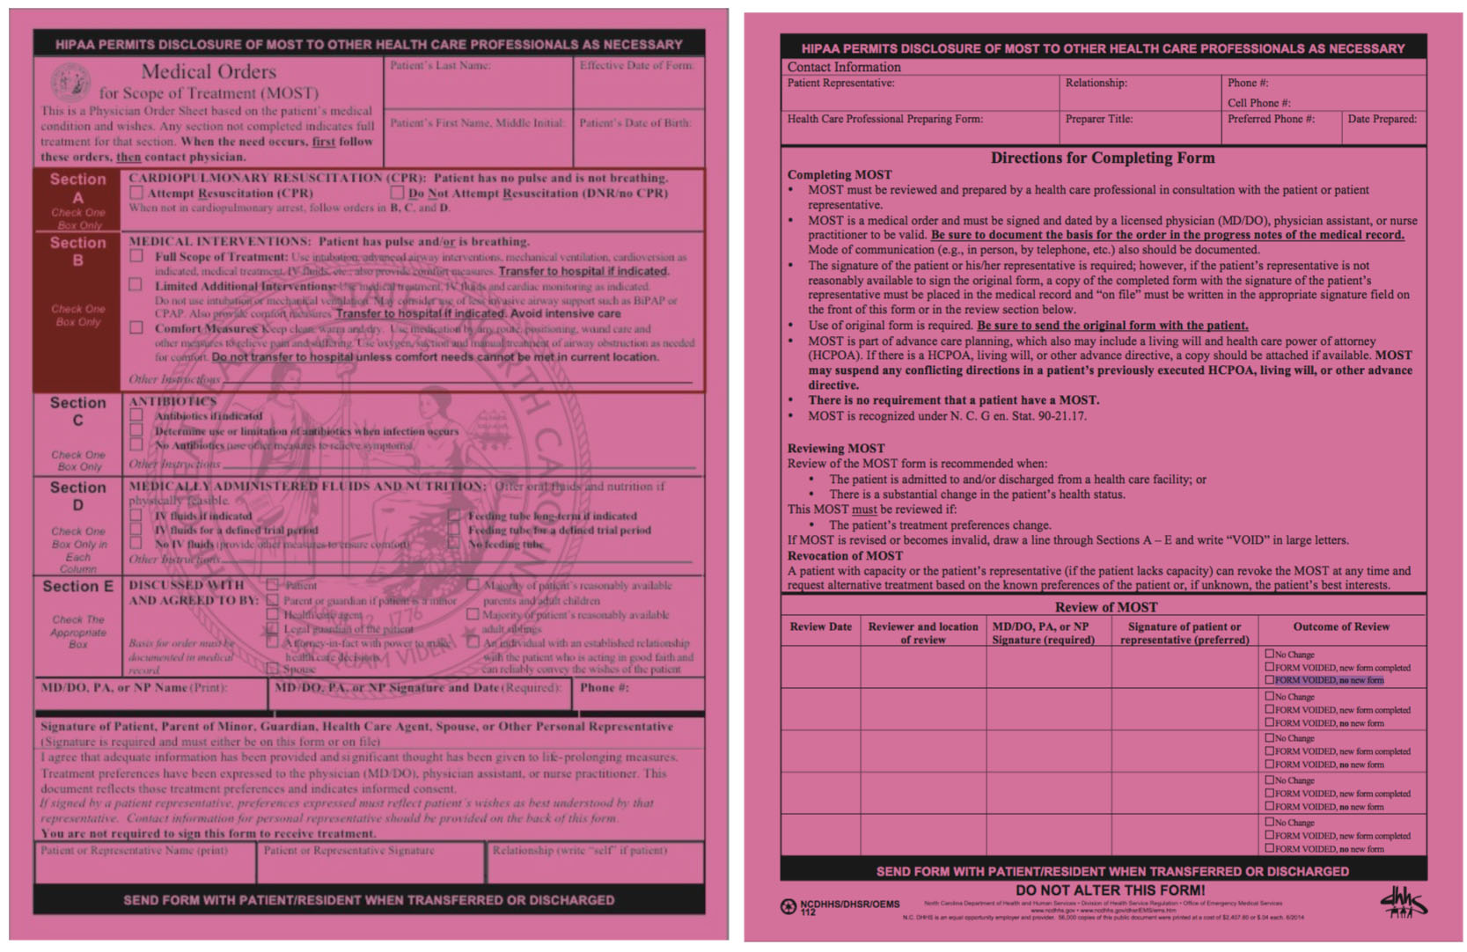

Slide 17
Advance Care Planning
It’s as simple as 1, 2, 3…
1
Decide what kind of health care you would want and who you would want to speak for you if you could not speak for yourself
We plan for
college, marriage,
a baby, & retirement…
but we don’t prepare
for the end of life.
Let’s change that!
2
Discuss your wishes with your loved ones and healthcare providers
3
Document your wishes in the form of an advance directive

